Slide 1

Refactoring and
Code Smells
Dan Fleck
Spring 2010
Coming up: Where are we?

Slide 2
Where are we?
Over the semester we have talked about Software Engineering.
The overall goal of software engineering is to create high quality software efficiently.
What if you don’t though? There are always pressures and reasons that software isn’t great
Coming up: Why do good developers write bad software?

Slide 3
Why do good developers write bad software?
Requirements change over time, making it hard to update your code (leading to less optimal designs)
Time and money cause you to take shortcuts
You learn a better way to do something (the second time you paint a room, it’s always better than the first because you learned during the first time!)
Two questions:
How do we fix our software?
How do we know our software is “bad”… when it works fine!
Coming up: Refactoring

Slide 4
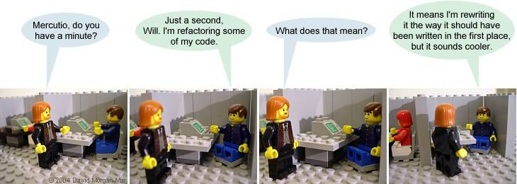
Refactoring
Definition: Refactoring modifies software to improve its readability, maintainability, and extensibility without changing what it actually does.
External behavior does NOT change
Internal structure is improved
Coming up: Refactoring

Slide 5
Refactoring
The goal of refactoring is NOT to add new functionality
The goal is refactoring is to make code easier to maintain in the future
Coming up: Refactoring Simple Example

Slide 6
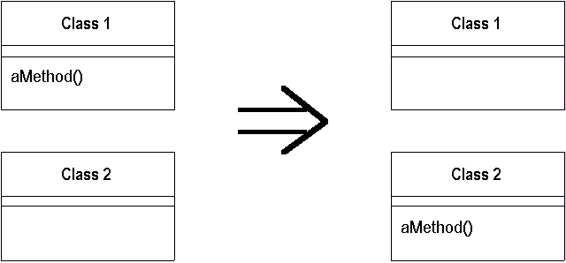
Refactoring Simple Example
Move a method:
Motivation: A method is, or will be, using or used by more features of another class than the class on which it is defined.
Technique: Create a new method with a similar body in the class it uses most. Either turn the old method into a simple delegation, or remove it altogether.
Coming up: Danger!

Slide 7
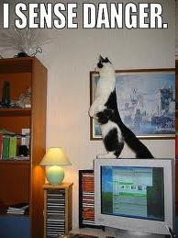
Danger!
Refactoring CAN introduce problems, because anytime you modify software you may introduce bugs!
Management thus says:
  Refactoring adds risk!
  It’s expensive – we’re spending time in development, but not “seeing” any
  external differences? And we still
  have to retest?
  Why are we doing this?
Coming up: Motivation

Slide 8
Motivation
We refactor because we understand getting the design right the first time is hard and you get many benefits from refactoring:
  Code size is often reduced
  Confusing code is restructured into simpler code
  Both of these greatly improve mainatainability! Which is required because requirements always change!
Coming up: Refactoring: Complex Example

Slide 9
Refactoring: Complex Example
Introduce Null Object
Motivation: You have many checks for null
Technique: Replace the null value with a null object.
Customer c = findCustomer(...);
...
if (customer == null) {
name = “occupant”
} else {
name = customer.getName()
}
if (customer == null) {
…
Coming up: Refactoring: Complex Example

Slide 10
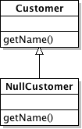
Refactoring: Complex Example
public class NullCustomer extends Customer {
public String getName() {
return “occupant”
}
------------------------------------------------------------
Customer c = findCustomer()
name = c.getName()
Completely eliminated the if statement by replacing checks for null with a null object that does the right thing for “null” values.
Coming up: Refactoring Example: Replace Conditional with Polymorphism

Slide 11
Refactoring Example: Replace Conditional with Polymorphism
Motivation: You have a conditional that chooses different behavior depending on the type of an object.
Technique: Move each leg of the conditional to an overriding method in a subclass. Make the original method abstract.
double getSpeed() {
switch (_type) {
case EUROPEAN:
return getBaseSpeed();
case AFRICAN:
return getBaseSpeed() - getLoadFactor() * _numberOfCoconuts;
case NORWEGIAN_BLUE:
return (_isNailed) ? 0 : getBaseSpeed(_voltage);
} throw new RuntimeException ("Should be unreachable");
}
Coming up: Refactoring Example: Replace Conditional with Polymorphism

Slide 12
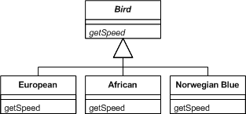
Refactoring Example: Replace Conditional with Polymorphism
Coming up: When do I refactor?
Notes:
More examples at http://www.refactoring.com/catalog/index.html

Slide 13
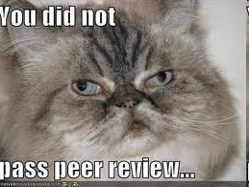
When do I refactor?
When you add functionality
  Before you add new features, make sure your design and current code is “good” this will help the new code be easier to write
When you need to fix a bug
When you do a peer review
Coming up: How do I identify code to refactor?

Slide 14

How do I identify code to refactor?
Martin Fowler uses “code smells” to identify when to refactor.
Code smells are bad things done in code, somewhat like bad patterns in code
Many people have tied code smells to the specific refactorings to fix the smell
Coming up: Code Smells

Slide 15
Code Smells
Duplicated Code
  bad because if you modify one instance of duplicated code but not the others, you (may) have introduced a bug!
Long Method
  long methods are more difﬁcult to understand
  performance concerns with respect to lots of short methods are largely obsolete
Coming up: Code Smells

Slide 16
Code Smells
Large Class
  classes try to do too much, which reduces cohesion
Long Parameter List
  hard to understand, can become inconsistent
Divergent Change
  Related to cohesion: symptom: one type of change requires changing one subset of methods; another type of change requires changing another subset
Coming up: Code Smells

Slide 17
Code Smells
Lazy Class
  A class that no longer “pays its way”
    e.g. may be a class that was downsized by a previous refactoring, or represented planned functionality that did not pan out
Speculative Generality
  “Oh I think we need the ability to do this kind of thing someday”
Temporary Field
  An attribute of an object is only set in certain circumstances; but an object should need all of its attributes
Coming up: Code Smells

Slide 18
Code Smells
Data Class
  These are classes that have ﬁelds, getting and setting methods for the ﬁelds, and nothing else; they are data holders, but objects should be about data AND behavior
Refused Bequest
  A subclass ignores most of the functionality provided by its superclass
  Subclass may not pass the “IS-A” test
Comments (!)
  Comments are sometimes used to hide bad code
    “…comments often are used as a deodorant” (!)
Coming up: Many more code smells

Slide 19
Many more code smells
Many more smells at:
  http://c2.com/cgi/wiki?CodeSmell
Given a smell, what refactorings are likly?
  http://wiki.java.net/bin/view/People/SmellsToRefactorings
Coming up: Why use them?

Slide 20
SMELLS EXAMPLE – See which smells you find in the sample code
Duplicated Code
Long Method
Large Class
Long Parameter List
Divergent Change- Related to cohesion: symptom: one type of change requires changing one subset of methods; another type of change requires changing another subset
Data Class - These are classes that have ﬁelds, getting and setting methods for the ﬁelds, and nothing else; they are data holders, but objects should be about data AND behavior
Refused Bequest - A subclass ignores most of the functionality provided by its superclass
Comments (!) - Comments are sometimes used to hide bad code
Lazy Class - A class that no longer “pays its way”
Speculative Generality - “Oh I think we need the ability to do this kind of thing someday”
Temporary Field - An attribute of an object is only set in certain circumstances; but an object should need all of its attributes
Notes:
CODE: http://vivekagarwal.wordpress.com/2008/06/21/code-smelling-exercise/#more-105

Slide 21
Why use them?
Code smells and refactoring are techniques to help you discover problems in design and implementation and apply known solutions to these problems
Should they be used all the time? You should always think about them, but only apply them when they make sense… sometimes you need a long method… but think about it to make sure!
Coming up: Adding safety

Slide 22
Adding safety
Remember that making these changes incurs some risk of introducing bugs!
To reduce that risk
  You must test constantly – using automated tests wherever possible
  Use refactoring patterns – I’ve shown you two… there are more.. many more!
    http://www.refactoring.com/catalog/index.html
  Use tools! Netbeans and Eclipse both support basic refactoring (http://wiki.netbeans.org/Refactoring)
Coming up: Question from your boss

Slide 23
Question from your boss
"Refactoring is an overhead activity - I'm paid to write new, revenue generating features."
Tools/technologies are now available to allow refactoring to be done quickly and relatively painlessly.
Experiences reported by some object-oriented programmers suggest that the overhead of refactoring is more than compensated by reduced efforts and intervals in other phases of program development.
While refactoring may seem a bit awkward and an overhead at first, as it becomes part of a software development regimen, it stops feeling like overhead and starts feeling like an essential.
Quoted from: http://st-www.cs.illinois.edu/users/opdyke/wfo.990201.refac.html
Coming up: Summary

Slide 24
Summary
Refactoring improves the design of software
  without refactoring, a design will “decay” as people make changes to a software system
Refactoring makes software easier to understand
  because structure is improved, duplicated code is eliminated, etc.
Refactoring helps you find bugs
  Refactoring promotes a deep understanding of the code at hand, and this understanding aids the programmer in finding bugs and anticipating potential bugs
Refactoring helps you program faster
  because a good design enables progress
Coming up: References

Slide 25
References
Comic from: http://www.irregularwebcomic.net/cgi-bin/comic.pl?comic=687
http://www.refactoring.com/catalog/index.html
http://www.cs.colorado.edu/~kena/classes/6448/s05/lectures/lecture18.pdf
http://www.codeproject.com/KB/architecture/practicalexp.aspx
Coming up: In-Class Exercise

Slide 26
In-Class Exercises
Example from http://www.codeproject.com/KB/architecture/practicalexp.aspx
Not written up as an inclass exercise, but could start as an example to find code-smells from.
Article shows refactoring and code smells in action
Code smells exercise also at: http://vivekagarwal.wordpress.com/2008/06/21/code-smelling-exercise/#more-105
End of presentation

